Slide 1
Microcontroller-Based Survey Vehicle
Final Year Undergraduate Project
Programme of Study:
Student Name:
Student Number:
Project Supervisor:
BEng Electrical and Electronic Engineering
Savan Lacmane
160466539
Dr Chris Phillips

Slide 2



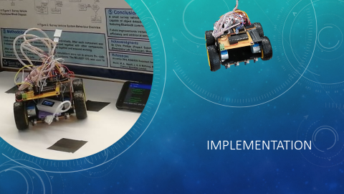

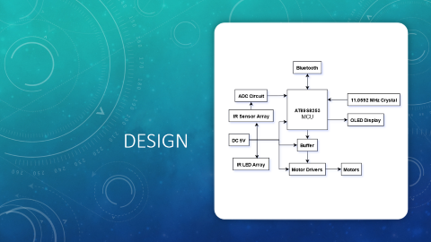




Slide 3



Motivation

Slide 4
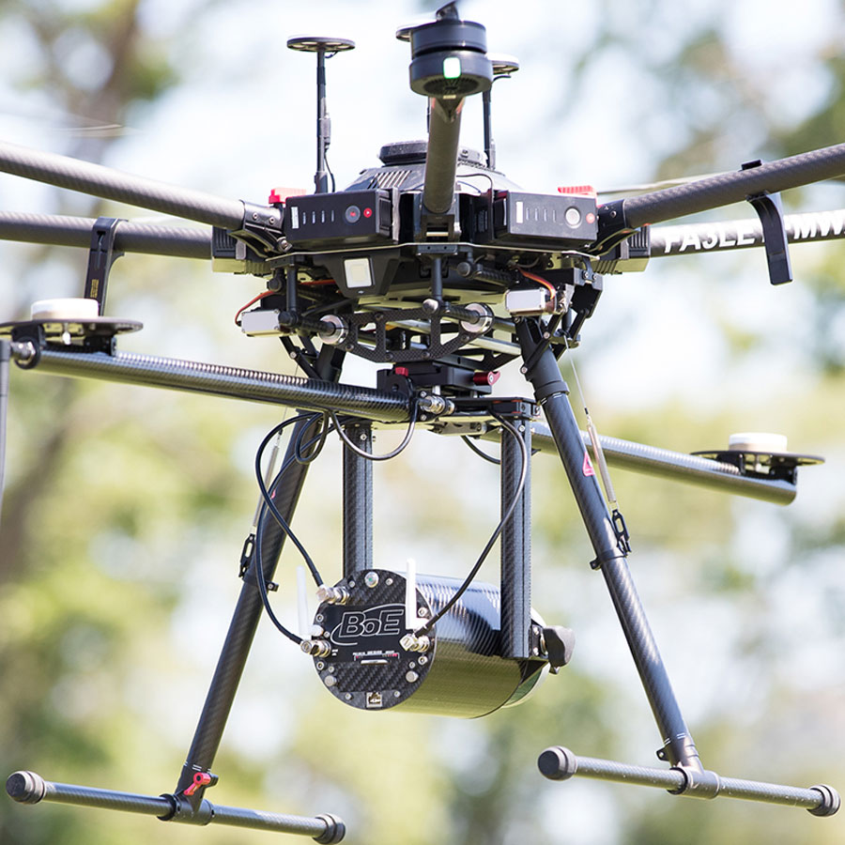
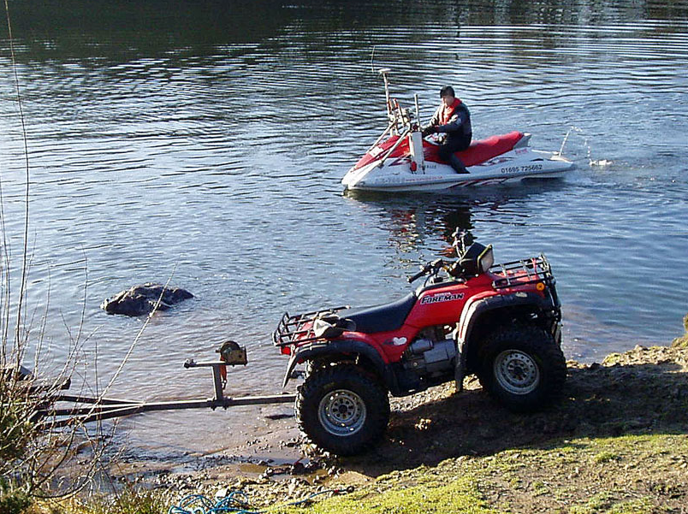

Motivation
Image from http://www.survops.co.uk
Image from http://www.survops.co.uk
Image from http://www.survops.co.uk
Aerial surveying using drones
Hydrographic surveying using jet skies
Coastal surveying using quad bikes
Notes:
Current methods: large, expensive, require trained personnel, permission to operate drone in area, short flight time
The main motive behind this project is to design and build a small, cost-effective survey vehicle, of which the features can be manipulated and applied in a wide variety of fields.

Slide 5

Aims and Objectives
Notes:
design and develop a small, cost-effective roaming vehicle that can survey an area of terrain, of which the features algorithms can be manipulated and applied in a wide variety of fields

Slide 6








Aims and Objectives
Notes:
Cost – low:
• be mass manufactured quickly and inexpensively
Efficiency – high:
• efficient in surveying and mapping by not overlapping an already covered area
Precision – moderate:
• move with a precision of about ±20cm, The vehicle should be capable of 45, 90, and 180 degree turns.
Mapping/location awareness – return to start:
• A mechanism for location awareness (and optionally orientation) needs to be included as well.
Autonomous scanning:
• follow a pre-programmed path and be able to autonomously scan an area
Survey terrain – object detection:
• The features which are surveyed will mainly include object detection and possibly others. The location of features will be mapped relative to the initial starting point rather than to a global positioning system reference.
Battery power – long usage time:
• The survey vehicle should also have efficient power management to allow for longer usage on battery power and reduce running costs.
Communication – Bluetooth:
• The system will receive movement instructions from another device via Bluetooth serial communication. It will also transmit mapped data over Bluetooth.

Slide 7
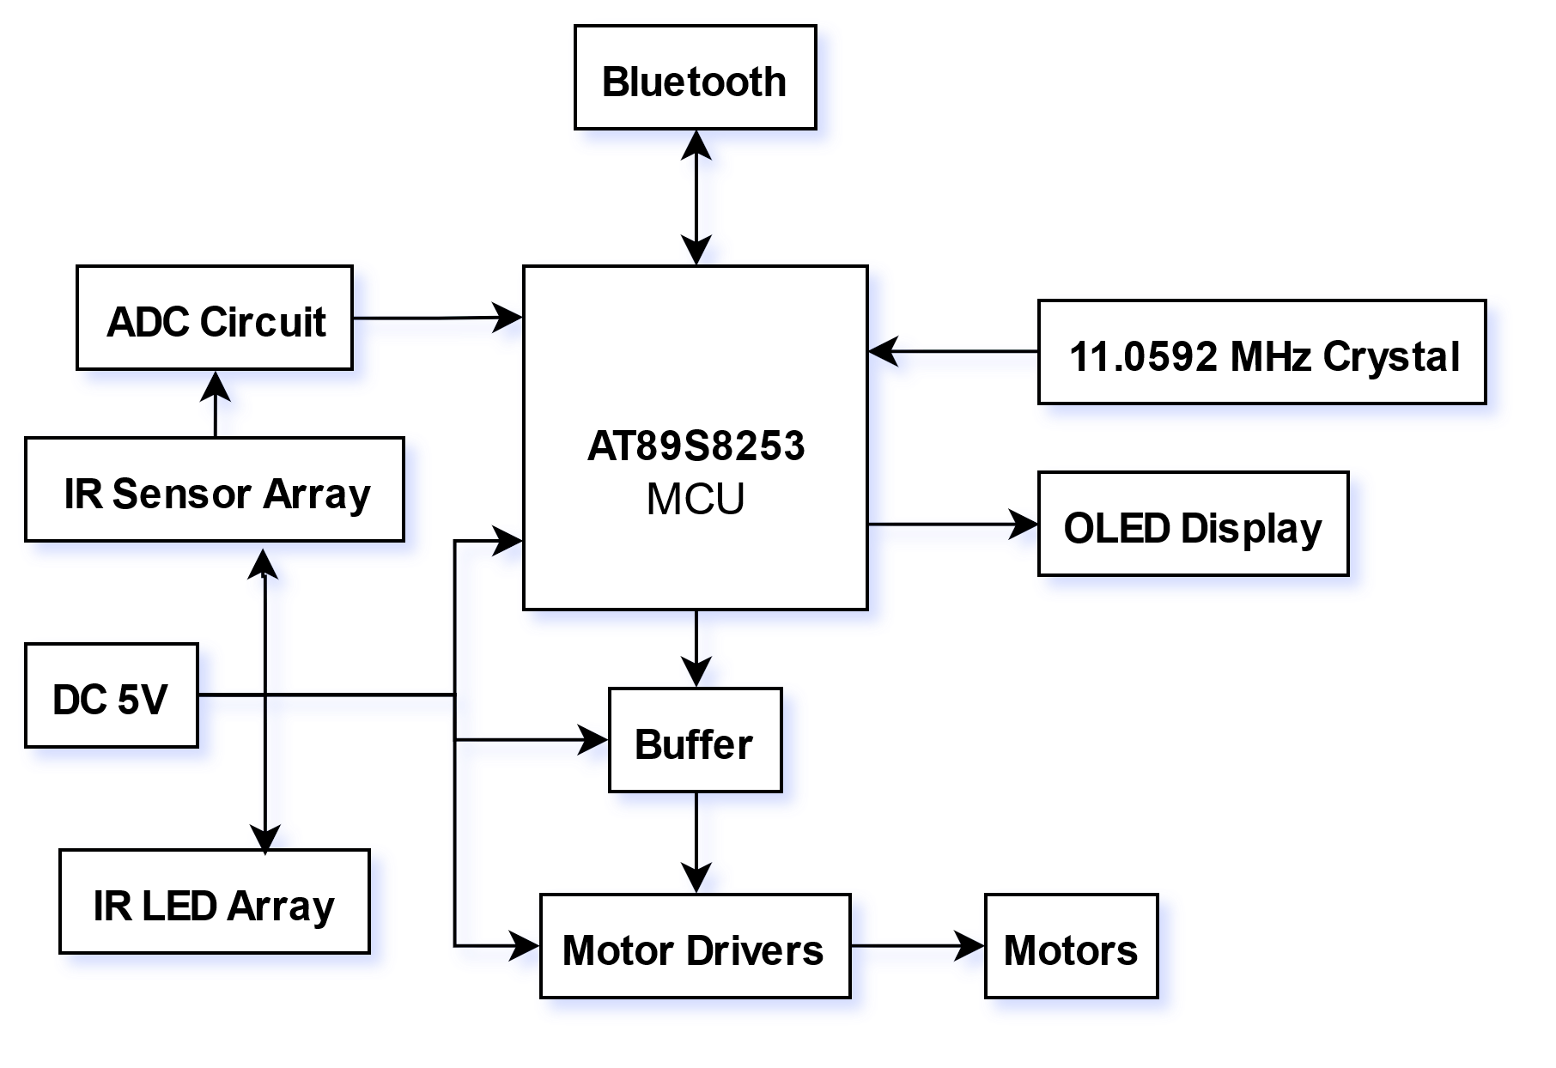
Design
Notes:
Functional block diagram – showing interfacing between components and microcontroller

Slide 8
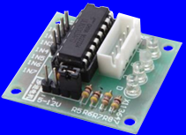
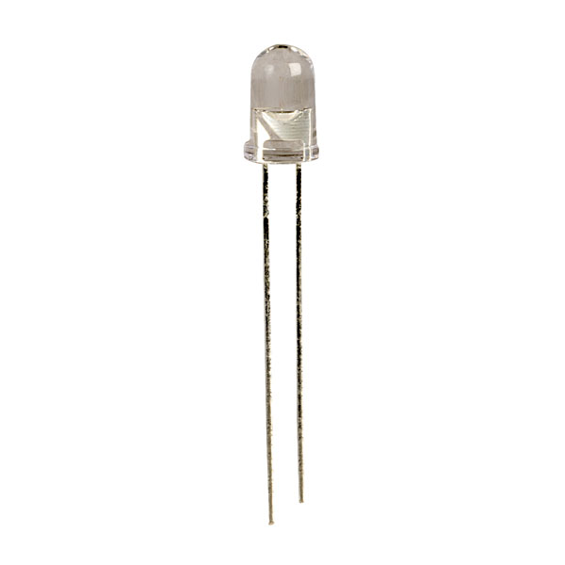
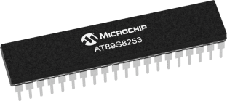
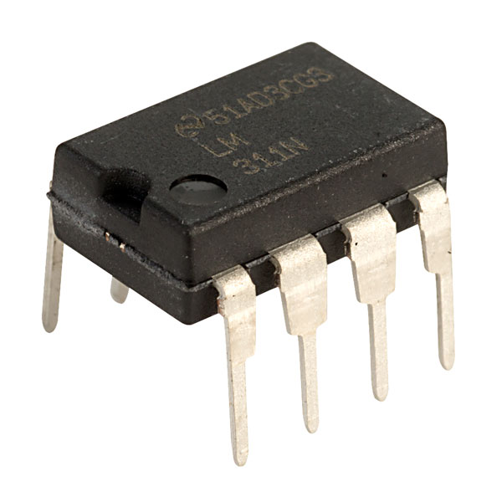
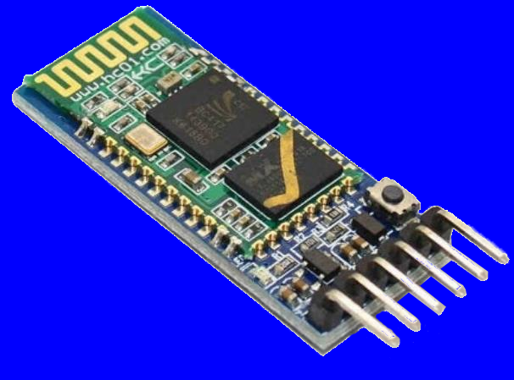
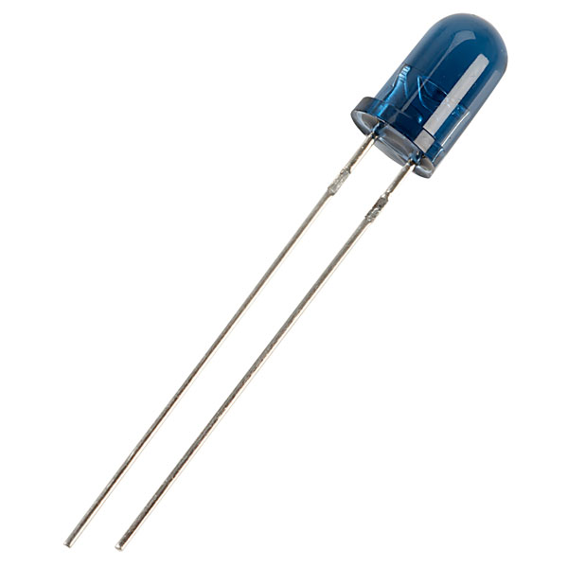
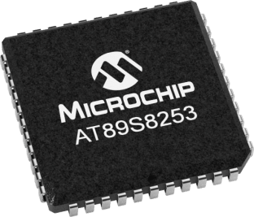
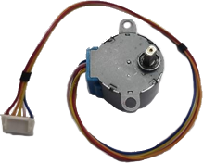
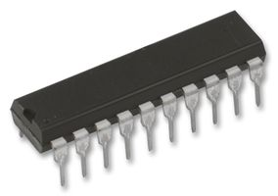
Design
AT89S8253
01
28BYJ-48
02
ULN2003
03
HC-05
04
Infrared
05
LM311
06
74HC244
07
Images from https://www.microchip.com
Images from https://www.amazon.com
Images from https://www.rapidonline.com
Image from https://www.uk.farnell.com
Notes:
8051 Microcontroller:
• More IO, larger EEPROM, readily program in assembly – more efficient, talk directly to cpu
Stepper Motors - precise movement
Drivers (amplifiers input signal current)
HC-05 Bluetooth - serial comms 9600 baud rate, can replace with USB wire, or Wi-Fi
Infrared LEDs and Sensors – emit light in infrared spectrum, sensor voltage changes depending on amount of light received; receive light, high voltage
ADC: differential comparator – compare sensor voltage to reference voltage

Slide 9
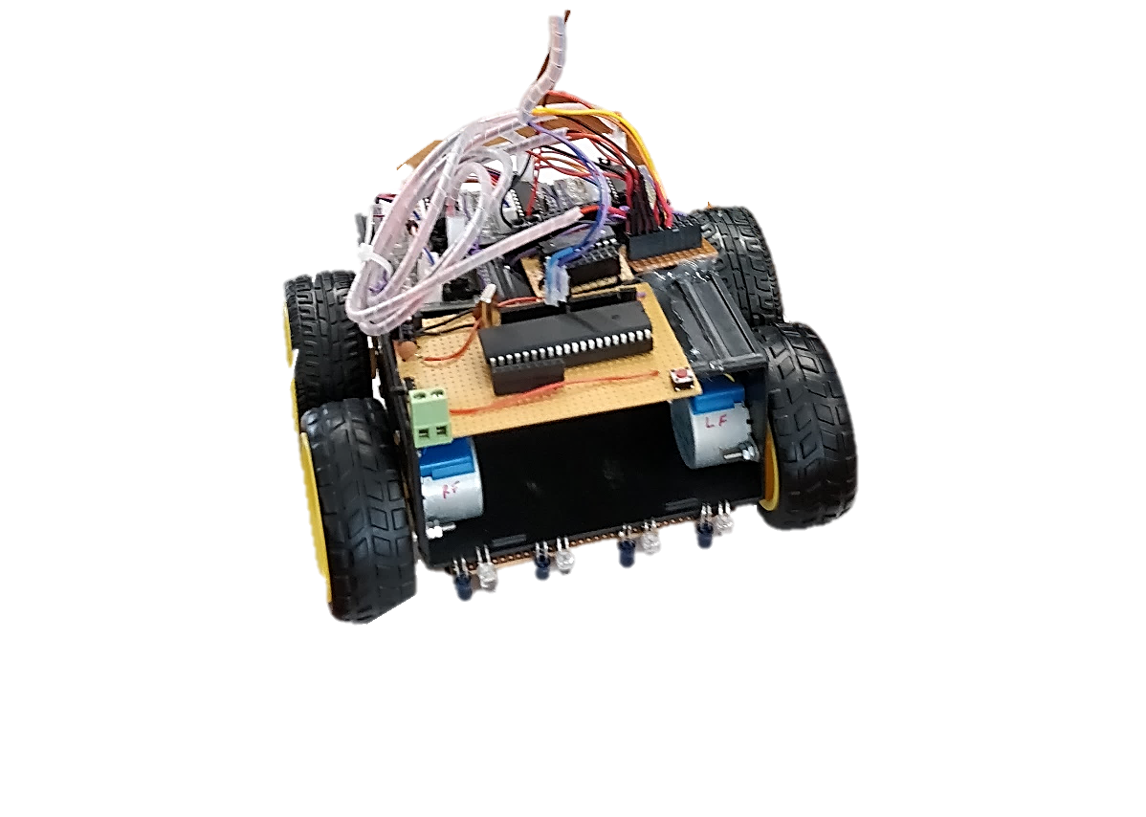
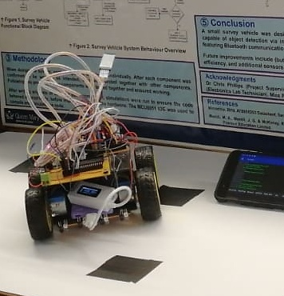
Implementation
Notes:
Prototype build of survey vehicle

Slide 10
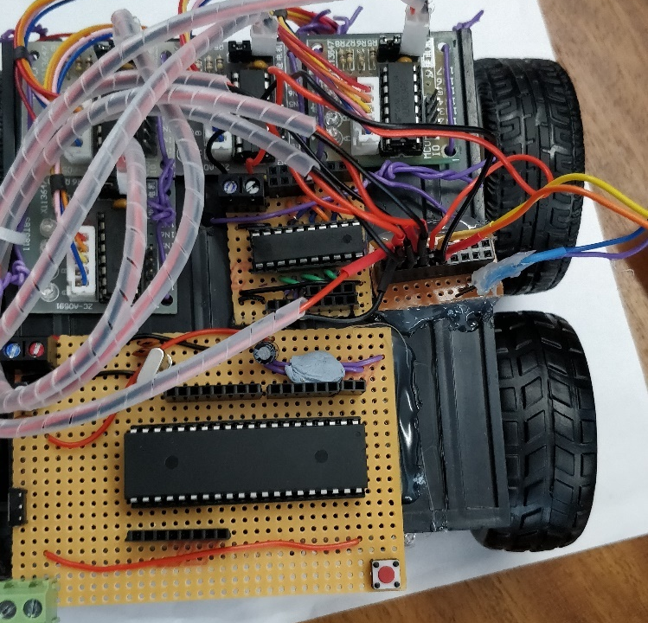
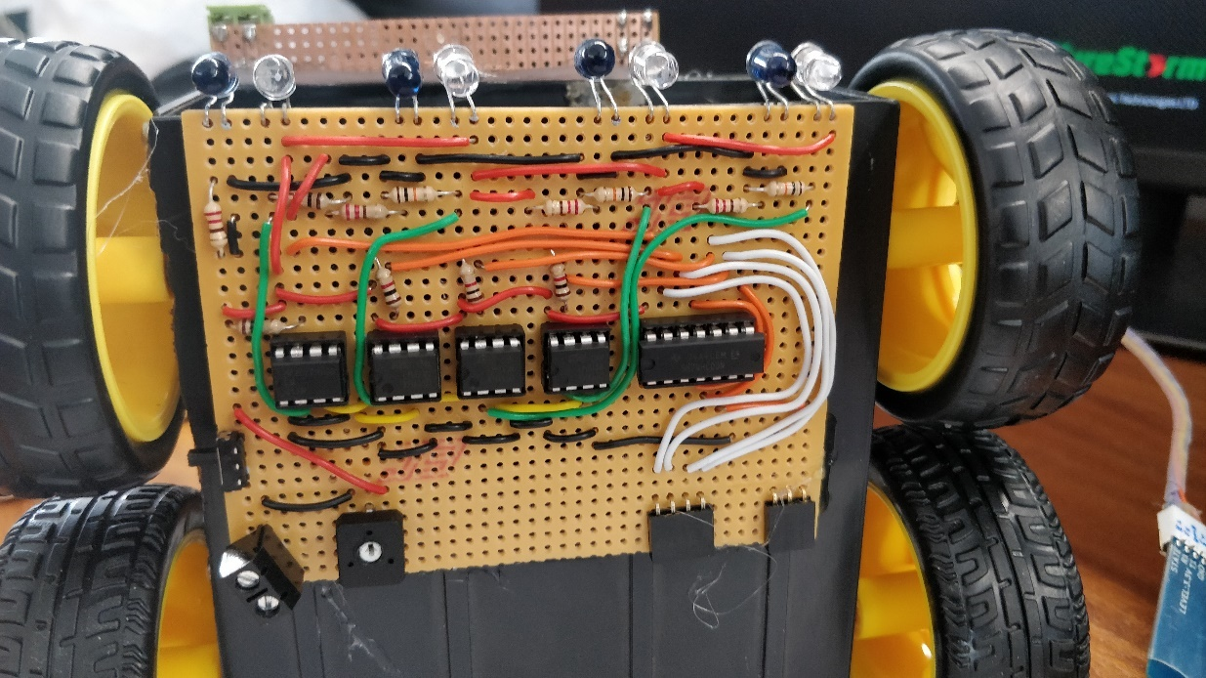
Implementation
Notes:
Left pic, top view, motor wires not shown connected.
Right pic, bottom view, IR and ADC; NAND logic gate added for single bit output, bit did not work. trimmer to adjust sensitivity of ADCs.

Slide 11
Implementation
Path Programming Algorithm
Object Detection
Vehicle Design
Movement
Location Mapping Algorithm
Power Consumption
Notes:
Path programming - User tells vehicle what path to follow, commands stored in internal EEPROM; retains data when power loss.
Object detection - Output of sensors go to ADC, ADC outputs goto microcontroller, which displays a status message when an object is detected.
Vehicle Design - Small form factor car, 550g, 14 x 17 x 24 cm (L x W x H), wheels dia 65mm.
Movement - travel about 20cm in one full revolution, speed of about 2.5cm per sec, 4 wheel drive, higher power to weight ratio, can pivot on spot for tighter turns.
Location Mapping – by tracking distance moved and direction faced, using motor steps
Power consumption - 5V supply, total power about 2.5W, battery with USB, battery used 2000mAh capacity, run for about 4hrs.

Slide 12


Prototype vs proposition
Notes:
The survey vehicle built as part of this project is a prototype design with numerous
areas that can be improved. Overall, the prototype build of the survey vehicle has met
most of the objectives and requirements

Slide 13









Prototype vs proposition
Low-Cost
Efficient Program
Precision
Mapping
Autonomous
Sensing
Power Efficient
Connectivity
Missing Features
Notes:
Low-cost - The vehicle was built using low-cost components that can perform the task required.
Efficient Program – written in assembly language, talking directly to CPU.
Precision – stepper motors, can move precisely, The vehicle is capable of 45° and 90° turns in both directions.
Mapping - A mechanism for location awareness is written as part of the program. The vehicle can keep track of its location relative to the initial starting point. Also has an algorithm for orientation.
Autonomous - The survey vehicle can follow a pre-programmed path, user programs the path to follow, vehicle then follows without any interruptions.
Sensing - The survey vehicle has an array of infrared LEDs and sensors, which are used to detect objects. The prototype build of the vehicle can differentiate a simple contrast in colours of black and white, where a black item is detected as an object.
Power efficient – uses about 2.5W when in full operation, when idle only a few mA. Runs off battery power, 2000mAh, size and capacity of most modern phones, can run for about 4hrs in full operation, or about 3 month in idle.
Connectivity – Bluetooth, serial, 9600 baud rate, vehicle controlled via simple commands sent over Bluetooth, vehicle outputs status to connected device, can be swapped for wired USB, or WiFi.
Missing features – does not return to start by self, no backwards movement or 180 degree turn, no OLED display, no path correction mechanism, doesn’t check for overlap in scanning.

Slide 14




Future improvements
Notes:
Missing features leads to future improvements, upgrade of features and programs.

Slide 15

Future improvements
Cleaner Design
Alternative Design
Improved Components
Program Update
Stand-alone Application
Notes:
Cleaner design – PCBs, CAD/CAM for design and manufacture.
Alternative design – aerial drone, hovercraft, submarine, plane.
Improved components – different motors for faster movement, suspensions for all terrain, different and more sensors for improved terrain surveying, compass for orientation and path correction, RADAR (radio waves) or LIDAR (laser light) to scan area, GPS, ultrasound for underwater, camera to differentiate objects, gas and temperature sensors, etc..
Program Update – refined algorithms, additional movement commands, improved object mapping, efficient scanning with no overlaps, return to starting position.
Stand-alone application – desktop, mobile, or web-app, simper interface with vehicle, graphic interface, seamless experience, store journey logs, real-time mapping,

Slide 16

conclusion
Notes:
A small car was built to roam and survey the terrain. Implemented a low-cost design, efficient program, low power.
The project was mostly successful, with some minor flaws outlined. Areas of upgradeability and improvement were mentioned.
The design methodology and algorithms implemented can be applied to similar projects, where another form of vehicle is to be designed to survey different features of the terrain, using a variety of sensors.

Slide 17


Thank You

Slide 18

References
DSD TECH, 2016. DSD TECH HC-05 Bluetooth. [Online] Available at: https://www.amazon.co.uk/dp/B01G9KSAF6
Farnell, 2018. SN74HC244N - Buffer / Line Driver, 74HC244, 2V to 6V, DIP-20. [Online] Available at: https://uk.farnell.com/texas-instruments/sn74hc244n/ic-buffer-line-driver-74hc244/dp/9591281
HiLetgo, 2018. HiLetgo 5pcs 28BYJ-48 5V Stepper Motor + ULN2003 Motor Driver Board for Arduino. [Online] Available at: https://www.amazon.co.uk/gp/product/B07B2TF2T8
Microchip, 2018. AT89S8253. [Online] Available at: https://www.microchip.com/wwwproducts/en/AT89S8253
Rapid Electronics Limited, n.d. Kingbright L-7113F3BT 5mm Blue Lens Infrared Diode. [Online] Available at: https://www.rapidonline.com/kingbright-l-7113f3bt-5mm-blue-lens-infrared-diode-58-0320
Rapid Electronics Limited, n.d. Kingbright L-7113P3C 5mm Phototransistor. [Online] Available at: https://www.rapidonline.com/kingbright-l-7113p3c-5mm-phototransistor-58-0325
Rapid Electronics Limited, n.d. Texas Instruments LM311N/NOPB High Speed Comparator. [Online] Available at: https://www.rapidonline.com/texas-instruments-lm311n-nopb-high-speed-comparator-82-0208
Survey Operations, 2018. Coastal Cliff & Dune Monitoring. [Online] Available at: http://www.survops.co.uk/surveying-news/coastal-cliff-dune-monitoring
Survey Operations, 2018. UAV Surveying. [Online] Available at: http://www.survops.co.uk/surveying-news/uav-surveying
Survey Operations, 2018. Waterways, Reservoirs & Lakes. [Online] Available at: http://www.survops.co.uk/waterways-reservoirs-lakes

